Slide 1
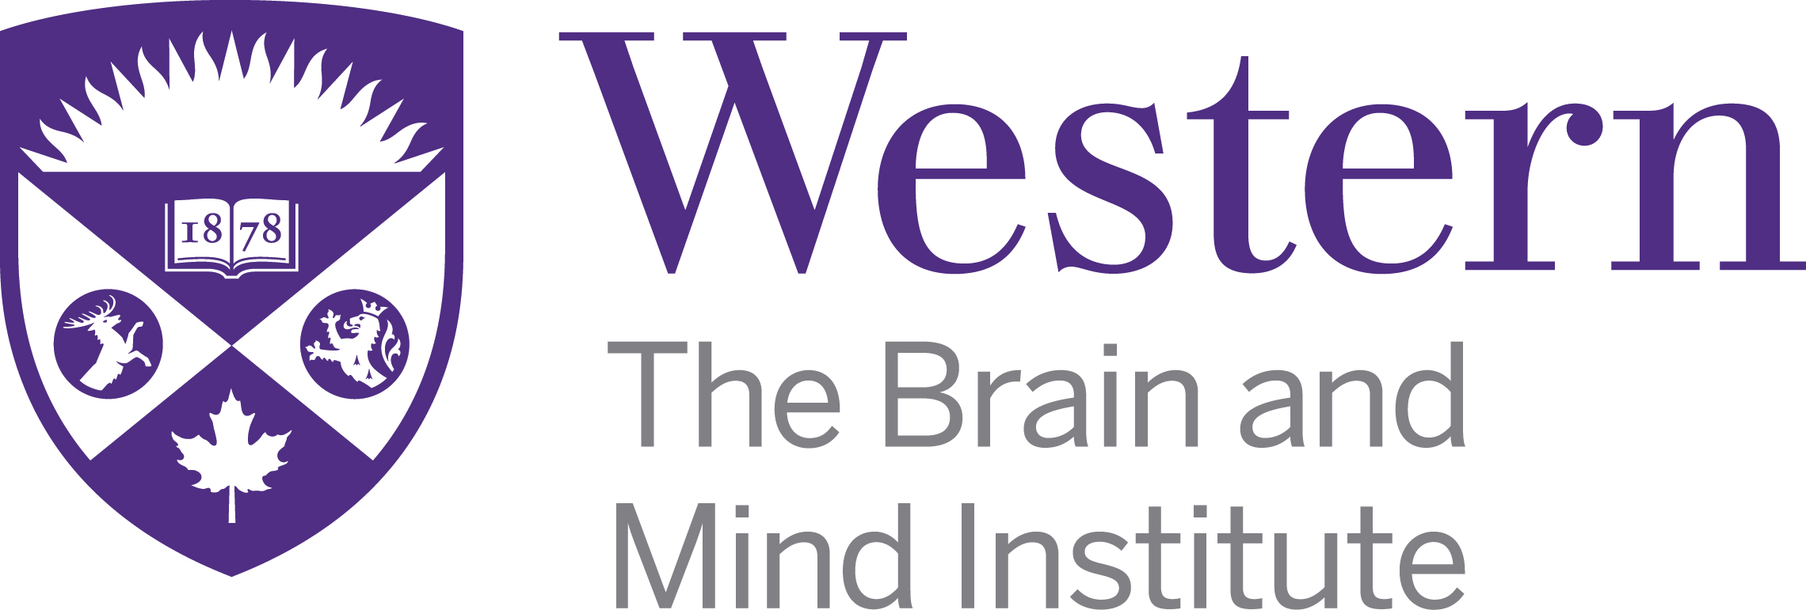
Image segmentation with few training samples using model-based augmentation
Jordan DeKraker
Supervisors: Dr. Ali Khan & Dr. Stefan Kӧhler
Notes:
General point: break down figures a bit more

Slide 2
Deep learning and number of samples
Deep learning generally requires lots of training samples for simple problems, and many more for complex ones
Why?
NNs will try to ‘cheat’ whenever they can
e.g. look at a few pixels, if they match ‘input A’ then produce ‘output A’ (1:1 mapping)
We need to force the network to learn deeper conjunctions of features by ‘swapping out’ features that are interchangeable
Having many samples means its easier to
detect regularities between higher-level ‘conjunctions’ of features
than it is to
match every low level feature

Slide 3
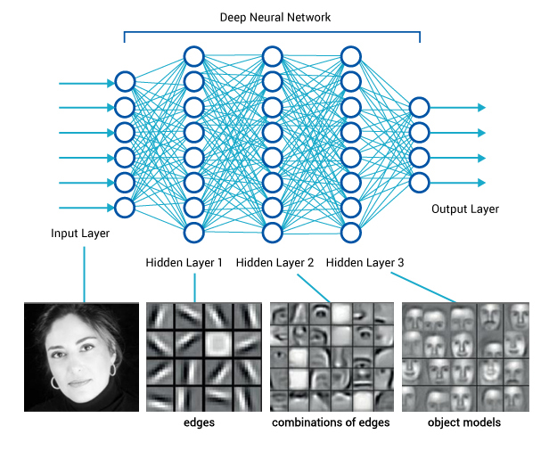
What do we mean by ‘higher level’ features?
Higher-level features can arise even when lower-level features are interchanged
They don’t depend on specific pixels, or specific locations of edges, but rather the conjunction of many features
‘Gestalt’
Multiply realizable

Slide 4
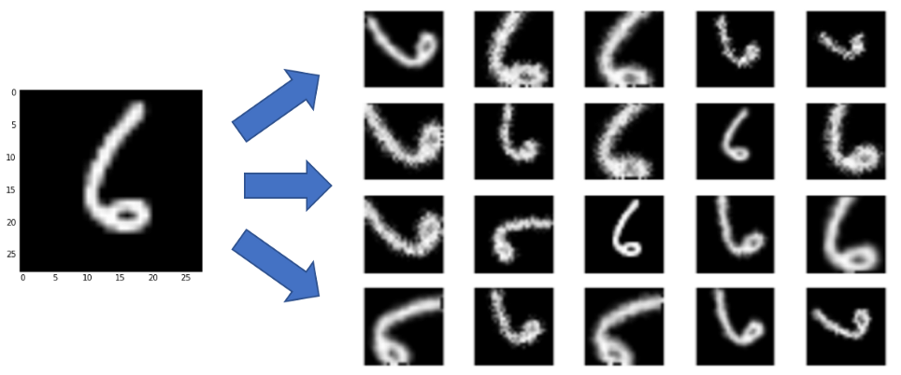
Image data augmentation 101
Augmentation changes pixel values without changing their higher-level features
E.g. random shifts, scales, rotations, flips, noise, diffeomorphisms
There is an infinite space of possible augmentations
However, augmentations need to be constrained:
Interchangeable (E.g. 180⁰ rotation 6→9)
Realistic (not helpful if never encountered in test datasets)
Affine
Also note: affine & noise only get you so far

Slide 5
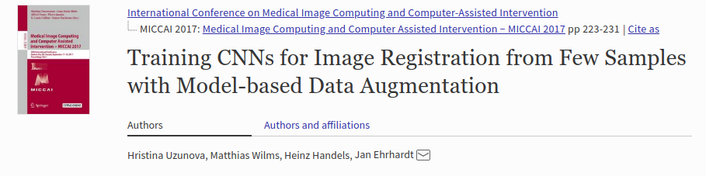
The basic idea: apply realistic augmentations
How can we generate a realistic diffeomorphisms of an MRI image?
Diffeomorphic registration to another MRI image!

Slide 6
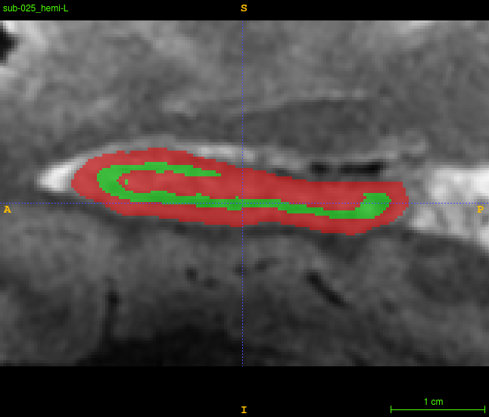
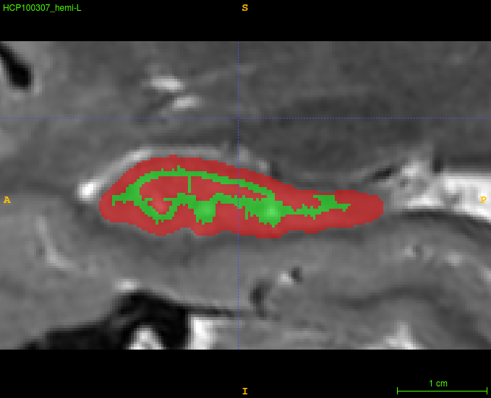
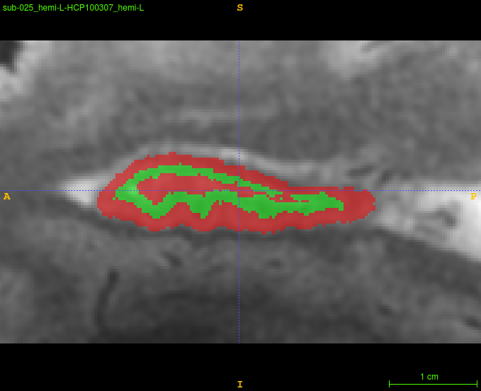
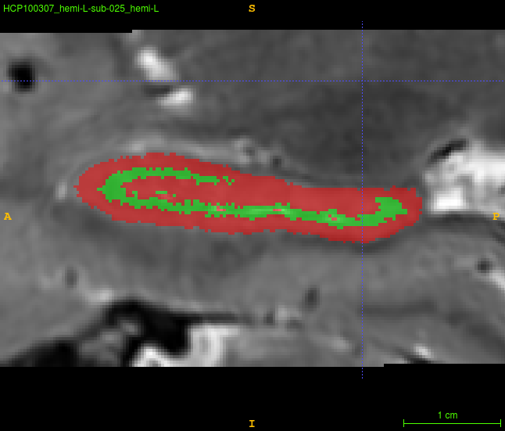
Example of a diffeomorphic registration:
Image1 (straight label; image fades out at bottom)
Image2 (wriggly label; good image contrast even at the bottom)
Image1r2 (wriggly label; image fades out at bottom)
Image2r1 (straight label; good image contrast even at the bottom)
Fully crossed, N images become N*N images
(but requires N*(N-1)/2 invertible registrations)

Slide 7
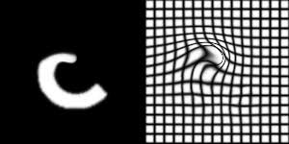
Points to consider
My diffeomorphic registrations were done on labelmaps, and those registrations were then applied to underlying images
This method can also be applied to image classification (registration of images within a class rather than labelmaps) or regression
Test data should still be completely independent
HOWERVER some images types should not be registered (e.g. discontinuous labels)
Registrations can be interpolated or extrapolated for infinite augmentation. HOWEVER all relevant image features should still be included in training
(i.e. we can recombine but not create features)
Notes:
Note: reorganize this slide!

Slide 8
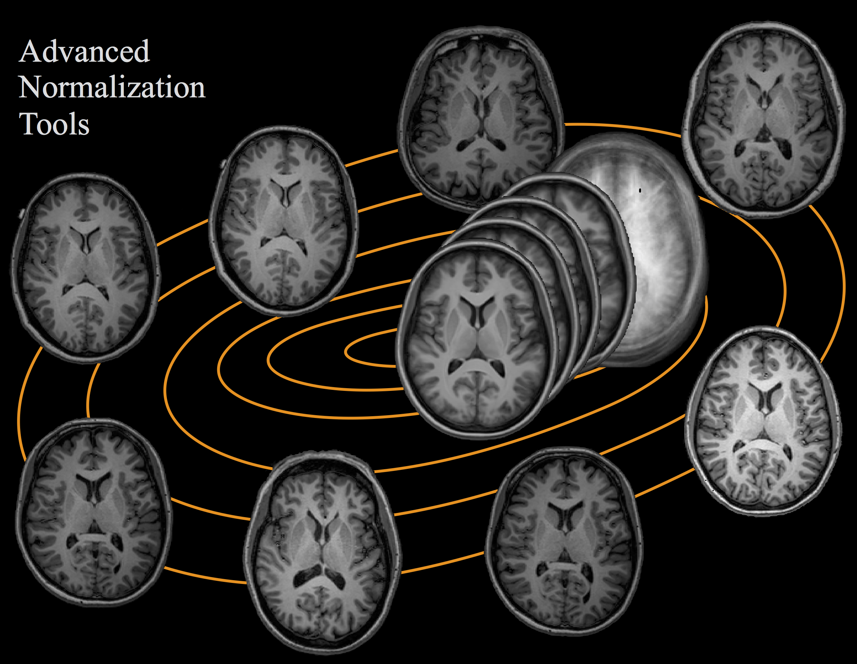
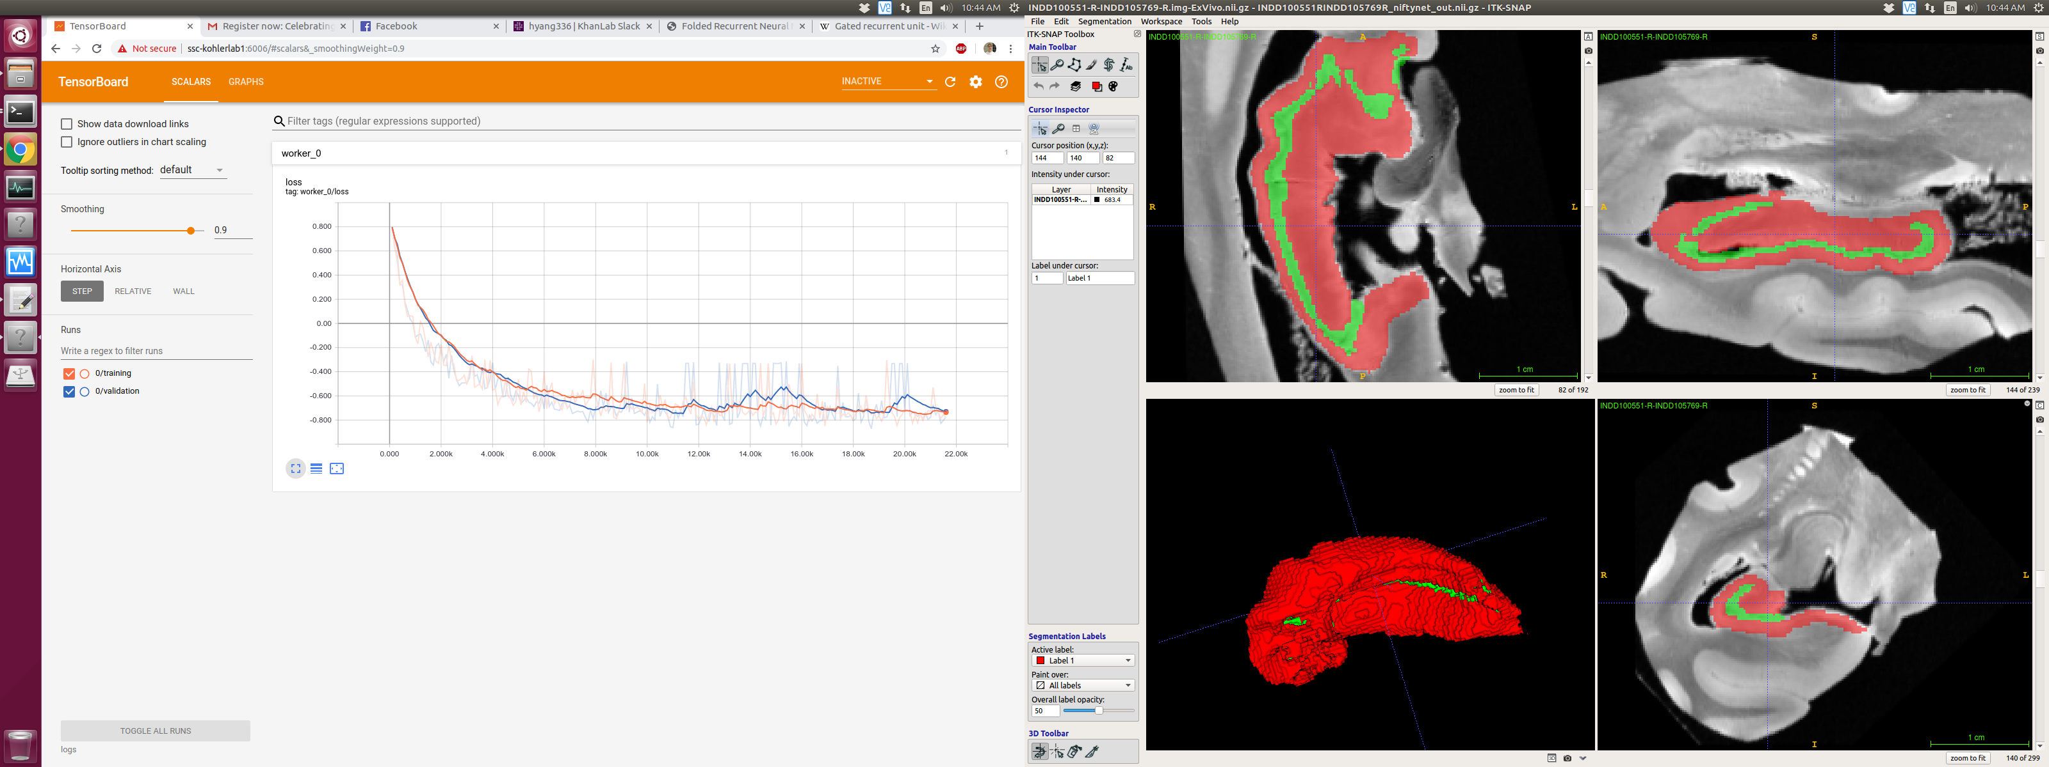
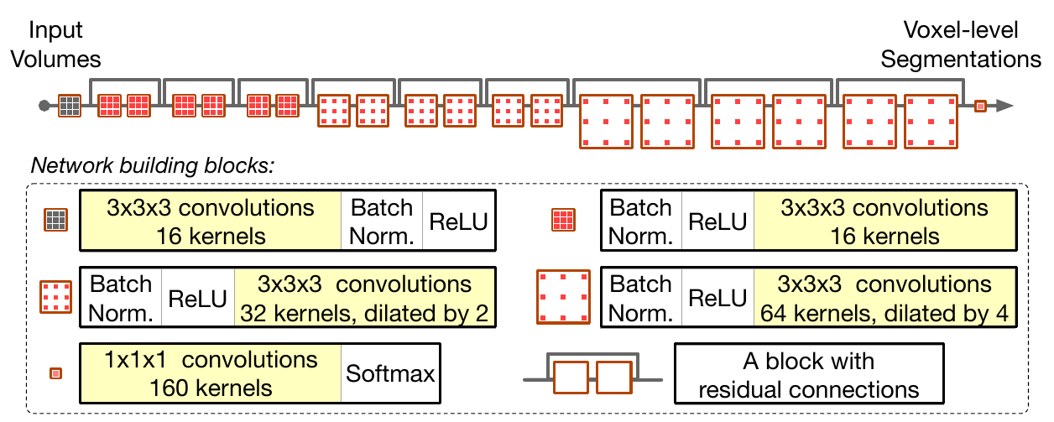
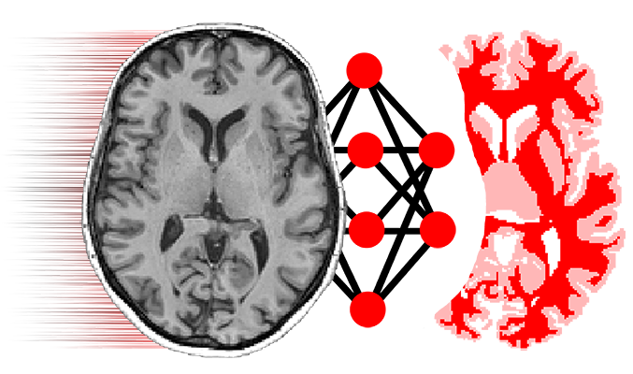
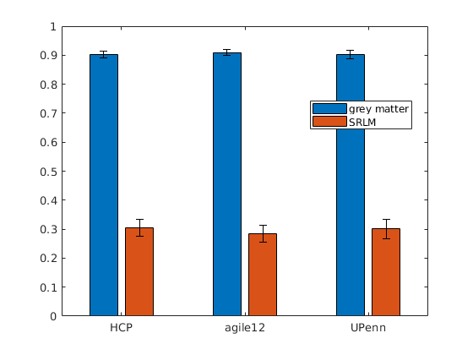
My project
Available data:
N=19, 3T MRI (HCP)
N=24, 7T MRI (UWO)
N=26, 9.4T MRI (UPenn)
Augmentation:
N=65 → N=4225
Training:
0.7 training; 0.2 validation; 0.1 test
Model is like a CNN + residual connections
Preliminary results:
Dice scores:
http://www.niftynet.io/

Slide 9
Thanks!
Example code, NiftyNet config file, and these slides can be found here:
https://github.com/jordandekraker/NiftyNet-ImageAugmentation
Note that there are additional ways to improve training with few samples!
Transfer learning (aka pretrained) models already available in NiftyNet
Semi-supervised & general learning (not yet fully explored, but very promising)
Stick around if you’d like visualizations of the data, live demos, or a walkthrough of my code
I’m also happy to help you get coding
Come talk to me!
jordandekraker@gmail.com
Khan lab area in RRI & WIRB
This pipeline could be further optimized and tested, or integrated into core NiftyNet

